Slide 1
6. Inductive reasoning
John P. McCrae
CT5166

Slide 2
Course structure
9th Sep | Introduction to Knowledge Graphs | 21st Oct | Inductive reasoning
16th Sep | Models for Knowledge Graphs | 28th Oct | KG Creation (no lab on Monday)
23rd Sep | Querying and Serialization | 4th Nov | KG Alignment
30th Sep | Schemas | 11th Nov | Publishing and Linked Open Data
7th Oct | Deductive reasoning | 18th Nov | Linguistic Linked Open Data
14th Oct | No Lecture | 25th Nov | Enterprise Knowledge Graphs

Slide 3
Inductive vs. Deductive
Deductive knowledge involves precise rule-driven generalisations
Inductive knowledge focus on likely knowledge, especially in incomplete graphs

Slide 4
Example
Capital City
airport
Paris
Charles de Gaulle
London
airport
Heathrow
All capital cities have an airport
Tokyo
airport
Narita
Madrid
airport
Barajas
Vaduz
96% of capitals have an airport

Slide 5
Graph Analytics

Slide 6
Central Node
Community
Unconnected Subgraph
Repeated Patterns

Slide 7
Key graph analytics
Centrality: Which nodes are the most important in a graph?
Community detection: Are there sections of the graph that are strongly interrelated?
Connectivity: Can you reach one part of the graph from another?
Node similarity: Are there patterns in the graph
Path finding/prediction: Provide routes or explanations for connecting entities in the knowledge graph

Slide 8

PageRank
Centrality algorithm that started Google
Random walk model
p₂=0.25
p₁=0.5
p₀=1.0
p₂=0.42
p₂=0.17
p₁=0.5
p₂=0.17

Slide 9
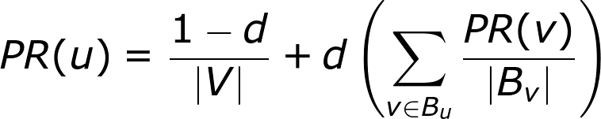
PageRank
The walker may stay at the same node, so there is also a probability, d, that the walker actually jumps
Probability of being at node u
Computation can be done either iteratively or by means of eigenvectors
Nodes connected from current node

Slide 10
Task
Implement PageRank iteratively

Slide 11
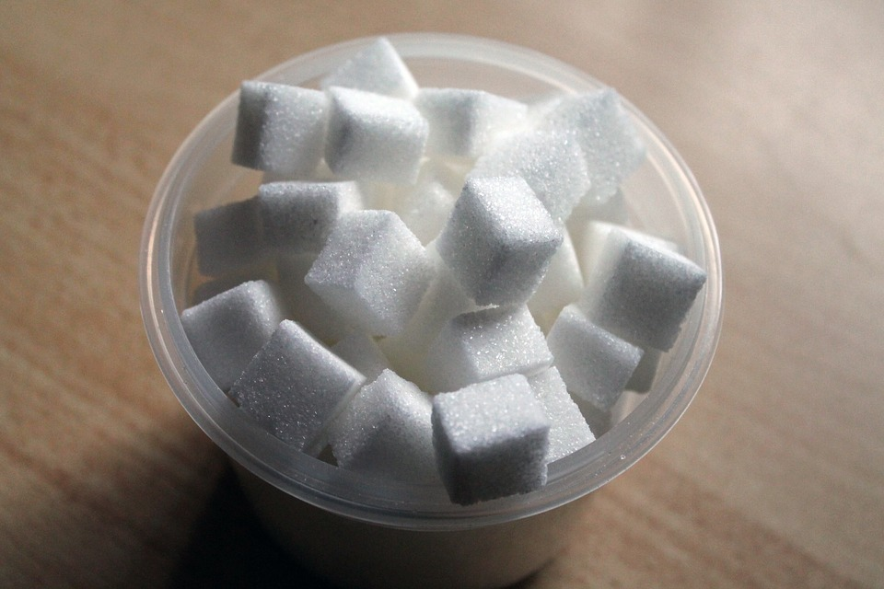

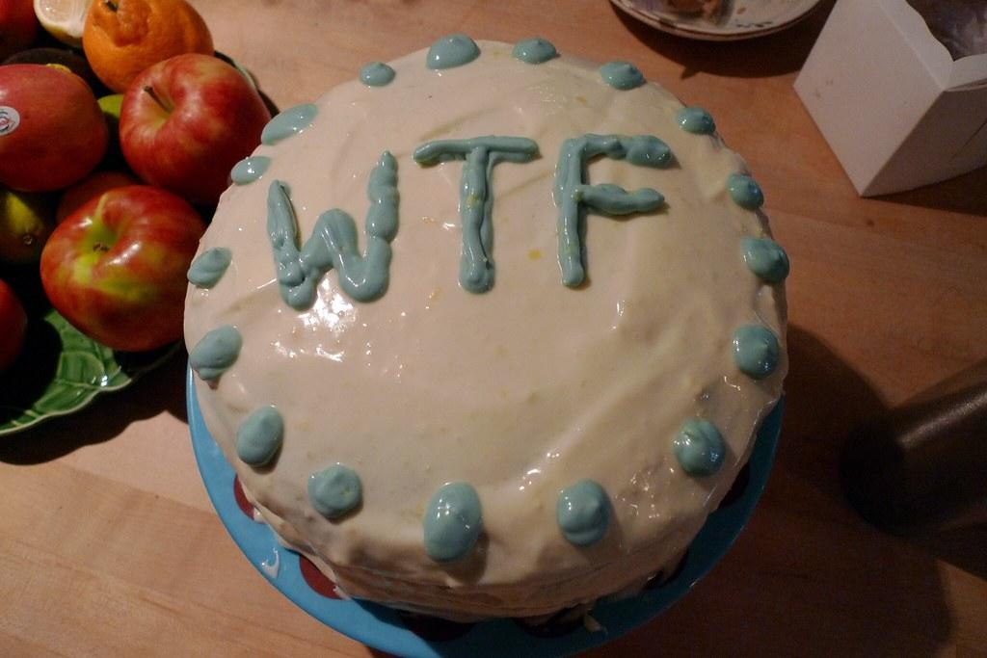
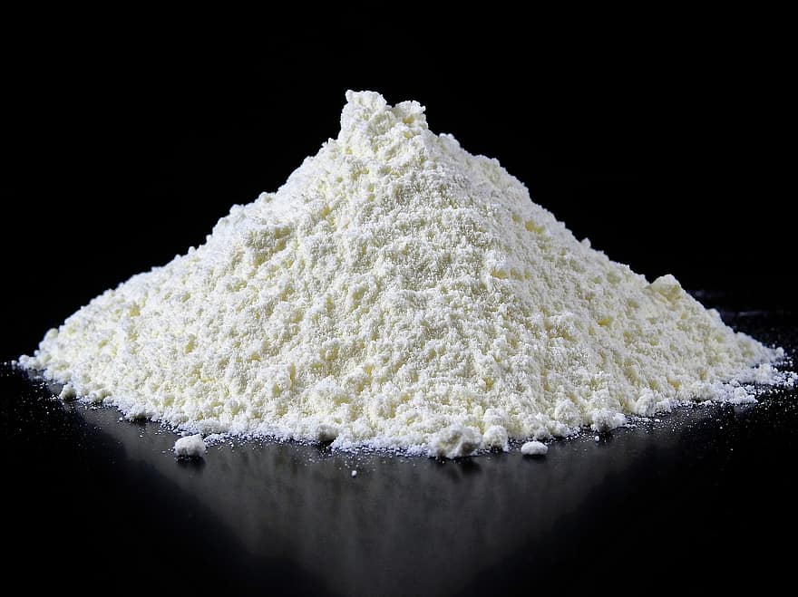
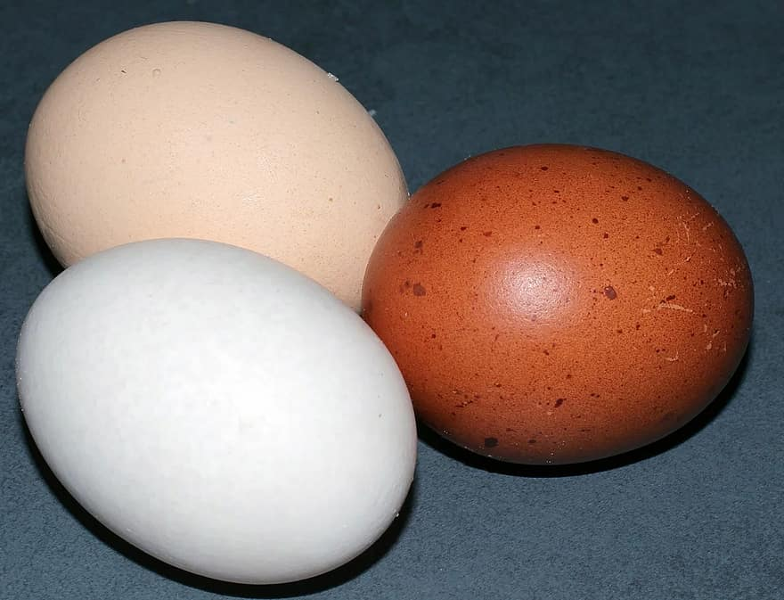
Message passing
Message: A vector of values to send to the next node
Aggregator: A function to combine the messages
End condition: Evaluates if the right result has been achieved

Slide 12
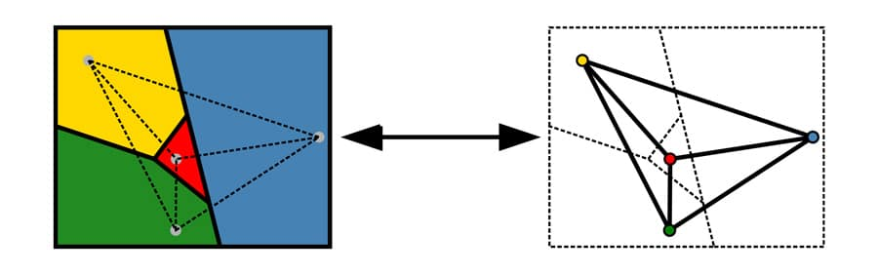
Example: Graph colouring
For a graph, where no node is connected to a node of the same colour (label)
Message: the colour of the node
Aggregator: choose a colour not in any message
End condition: no neighbouring nodes have the same colour

Slide 13
Edge labels - lossless transformation
airport
London
airport
Heathrow
London
country
UK
Heathrow
country
Manchester
UK
country
PageRank (and similar algorithms) do not use the edge label
Manchester
What does this remind you of?

Slide 14
Edge labels - lossy transformation
airport
London
airport
Heathrow
London
country
UK
Heathrow
country
country
Manchester
UK
Sometimes a lossy transformation is better for the application
Manchester

Slide 15
Graph
Embeddings

Slide 16
One-hot embedding
Each node has a different vector with a single non-zero value
Very large vectors
Does not capture graph structure
We would like to map to a lower dimensional space
1
0
0
0.2
0.7
0
0
1
0.8
0.5
0
1
0
0.2
0.3

Slide 17
Plausibility
We should be able to construct the graph from the embeddings, e_{s}, e_{o}, r_{p}, with a probability function f
f(e_{s}, r_{p}, e_{o}) ≃ 1 if (s, p, o) ∈ E
f(e_{s}, r_{p}, e_{o}) ≃ 0 if (s, p, o) ∉ E
Nodes are from the same vector space, properties have a different space. There are generally far more negative examples than positive.

Slide 18
TransE - Translational Embeddings
TransE attempts to find embeddings such that
e_{s} + r_{p} ≃ e_{o}
Negative samples are created by replacing either the subject or object node with a random node
r_{p}
e_{s}
e_{o}

Slide 19
TransE - Translation Embedding
Distance function, e.g., Euclidean ||x - y||
Margin hyperparameter
Corrupted triple:
Either (s’, p, o) or (s, p, o’)
[x]₊ = x if x > 0
[x]₊ = 0 otherwise
Generally solved by creating mini-batches and gradient descent

Slide 20
Adjacency matrix and tensor
The adjacency matrix of a graph is a matrix that summarizes the edges
We have a matrix for each relation which we can combine in a 3-dimensional tensor
0 0 0 1
0 0 1 0
0 0 0 1
0 0 0 0
2
3
0 1 1 0
0 0 0 0
1 0 0 0
0 0 0 0
1
A 4x4x2 tensor
4

Slide 21
Tensor Embedding
Z =
G =
|V| ✕ |P| ✕ |V| Adjacency Tensor
K ✕ L ✕ K Embedding Tensor

Slide 22
Dimensionality Reduction
Reducing by 2nd dimension:
G ≃ ZB = Z ×₂ B
Reducing by 1st dimension:
G ≃ Z^{T}A = Z ×₁ A

Slide 23
Tensor Dimensionality Reduction
Reducing by 3rd dimension:
G ≃ Z ×₃ C
Reducing by all dimensions:
G ≃ Z ×₁ A ×₂ B ×₃C
g_{pqr}= Σ_{i}Σ_{j}Σ_{k}a_{ip}b_{jq}c_{rk}z_{ijk}

Slide 24
TuckER decomposition
TuckER decomposition assumes that G ≃ Z ×₁ E ×₂ R ×₃ E
The probability of a link is given as
p(s, p, o) = σ(Z ×₁ e_{s} ×₂ r_{p} ×₃ e_{o})
TuckER decomposition minimizes:

Slide 25
RDF2Vec
Language models are already proven and effective for embedding
Generate “sentences” by random walk:
“London type capital_city type⁻¹ Paris”
“Heathrow airport London type capital_city”
Capital City
Charles de Gaulle
airport
London
Paris
airport
Heathrow

Slide 26
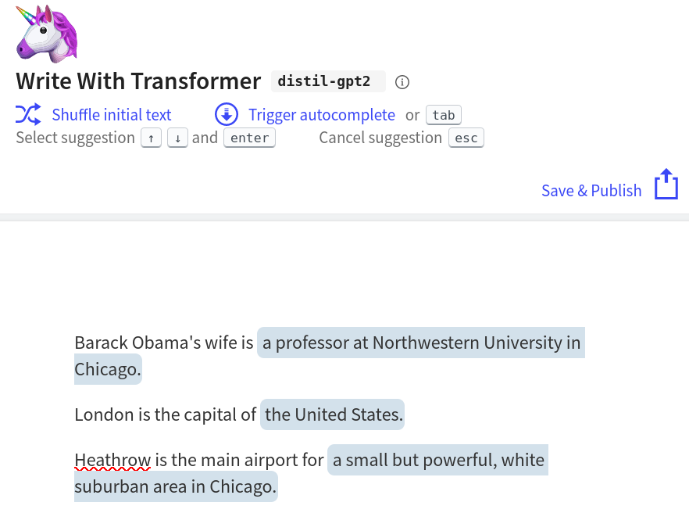
Language models vs. knowledge graphs
Large language models already contain many facts.
We may not need general-purpose knowledge graphs soon
KGs improve performance of large language models
…or maybe not?

Slide 27
Graph Neural Networks

Slide 28
Supervised Application of Embeddings
-0.2
0.3
0.4
0.8
-0.3
0.4
-0.9
0.7
SVMs, Naive Bayes,
Perceptrons, etc.
Node quality estimation
Importance for summarization
Real-world fact

Slide 29
Graphs for recommendation
Can you recommend me movies like Gremlins and Home Alone?
Christmas
Home Alone
Monster Film
Gremlins
Family Movie
Pacific Rim
Christopher Columbus
Harry Potter
Harry Potter.
Task covers multiple input nodes

Slide 30
Recurrent graph neural network
Recurrent graph neural networks have a hidden representation based on the neighbouring nodes
Christmas
Monster Film
Gremlins
Family Movie
Neural network
Christopher Columbus
Hidden state of node n at time t
Hidden state of neighbours and property embeddings

Slide 31
RecGNNs and Message Passing
RecGNNs are a special case of message passing
Message is the hidden representation
Aggregator is a neural network
Iterate to reduce loss, e.g., recommendation accuracy

Slide 32
Graphs as images
Christmas
Home Alone
Adjacency Matrix
Gremlins
Family Movie
Christopher Columbus
Harry Potter
Looks like an image! Can we use computer vision techniques?

Slide 33
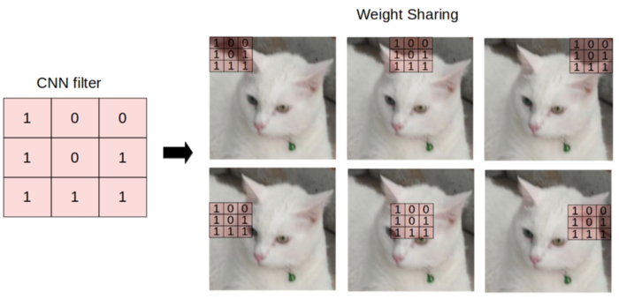
Graph Convolutional Neural Networks
In computer vision, we use convolutions to extract features from images
Conv GNNs have a fixed depth in contrast to RecGNNs
Use adjacency matrix as the convolution
A
A
A
X
h₁
h₂
Y
Image Source: https://towardsdatascience.com/understanding-graph-convolutional-networks-for-node-classification-a2bfdb7aba7b

Slide 34
Summary

Slide 35
Conclusion
Inductive knowledge extracts hidden information from graphs
Graph analytics directly analyse the graph
Embeddings are a powerful way of capturing graph structure
Supervised (and unsupervised) problems can be solved by means of neural networks based on graphs.

